Slide 1


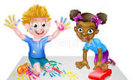
Certificate of Appreciation
This is awarded to:
Rasa Kaciusiene
For being part of a linked project between nurseries
sharing stories, artwork and lifestyles that have been proudly
displayed in our setting.

